Slide 1
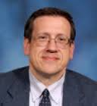
Larry Honigford, Physical Science,Lakota East, gr. 9
Marie Inanli, Middle School Science, in transition
Area Coordinator:
Dr. Anastasios
Angelopoulos
Graduate Research Assistants:
Abhinandh
Sankar
RET is funded by the
National Science Foundation
grant # EEC-1404766
Kevin Tonnis
Identification and Measurement of Metal Complexes in Solution for Alternative Energy Development

Slide 2
Table of Contents
Introduction
Literature Review
Background
Renewable Energy
VRFB
Research
Unit Plans
Bibliography
Acknowledgements
3
4
5
8
10
15
31
33

Slide 3
Introduction
Research methods to
monitor state of charge
in Vanadium Redox Flow Batteries
Uses Visible Spectroscopy
to measure concentration
of vanadium species.
Image credit: http://moodle.lctn.org/course/view.php?id=492

Slide 4
Literature Review
Image credit:Wikimedia

Slide 5
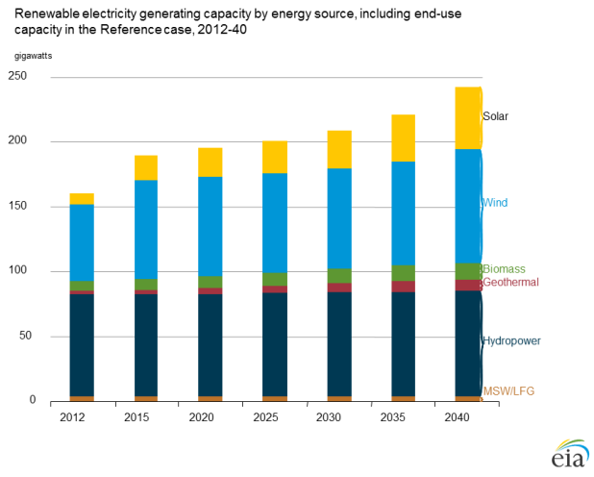
Background
Renewable Energy Capacity
Source: U.S. Energy Information Administration, Annual Energy Outlook 2014

Slide 6
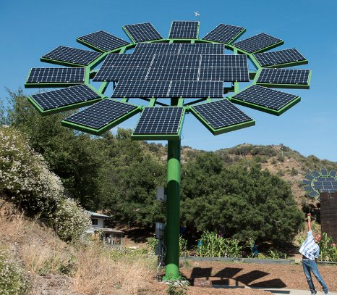
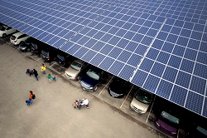
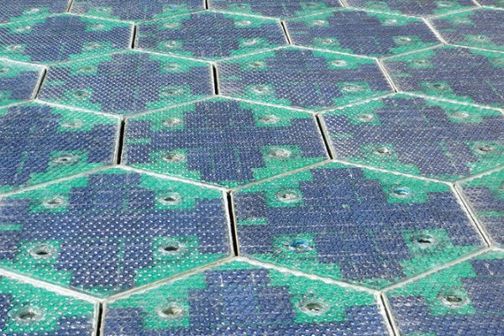
Background
Renewable Energy
Solar
The Cincinnati Zoo solar canopy Photo credit: Cincinnati Zoo

Slide 7
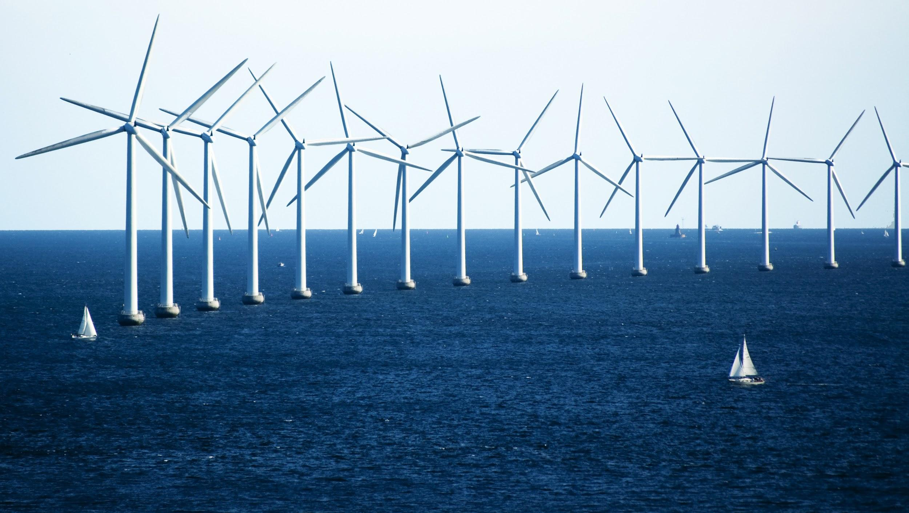
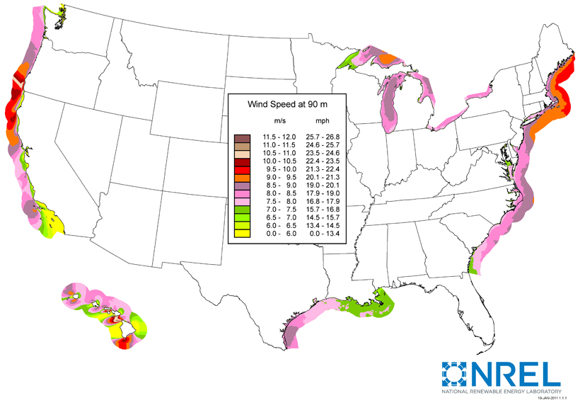
Background
Renewable Energy
Wind
Source: SNL Energy (July 2012)
http://www.nrel.gov/gis/images/offshore_
wind/US-offshore-windmap-90-dpi600.jpg
U.S. Department of Energy
Notes:
With more than 50% of the U.S. population living within 50 miles of a coastline, capturing wind off America’s shores has the potential to provide energy to countless homes and businesses

Slide 8
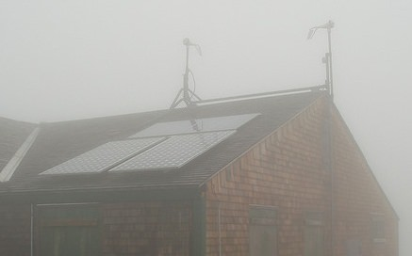
Background: Limitations
Solar and wind power
are intermittent
Premium power
price for industrial
renewable energy
producers
http://www.solarpowerrocks.com/solar-basics/
how-do-solar-panels-work-in-cloudy-weather/

Slide 9
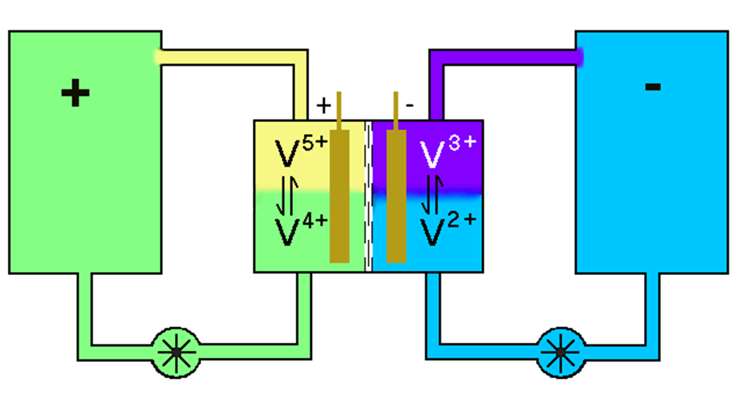
Vanadium Redox Flow Battery
Your slide text

Slide 10
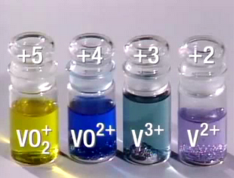
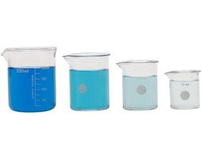
Research Goal
Research State of Charge Monitoring using UV-Vis Spectroscopy
BEER-LAMBERT LAW
Image credit: https://i.stack.imgur.com/4VAJz.png
http://www.ehow.com/how_8239523_calculate-concentration-extinction-coefficient.html

Slide 11
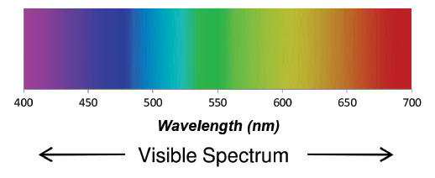
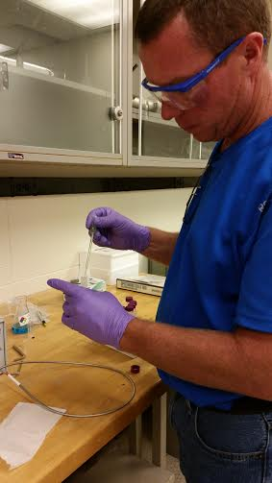
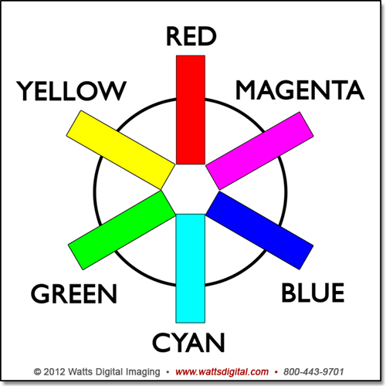
Research Project
UV-Vis
Spectroscopy

Slide 12
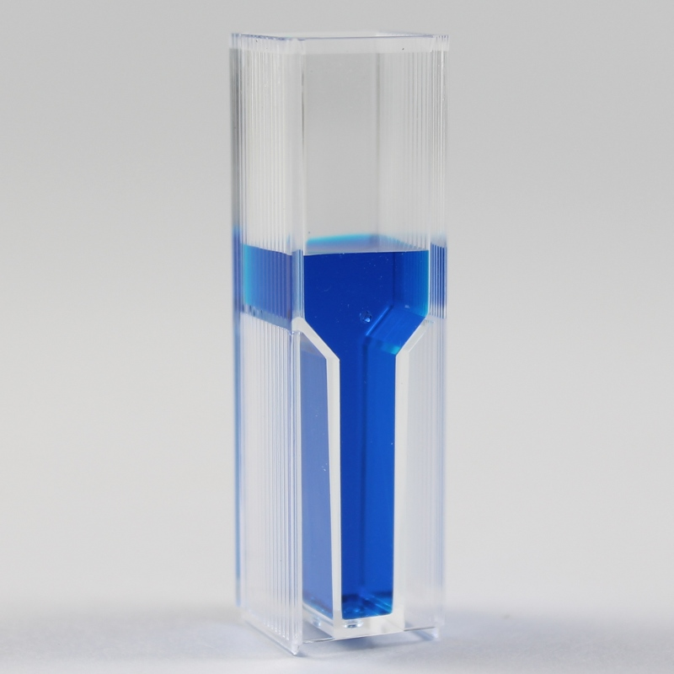
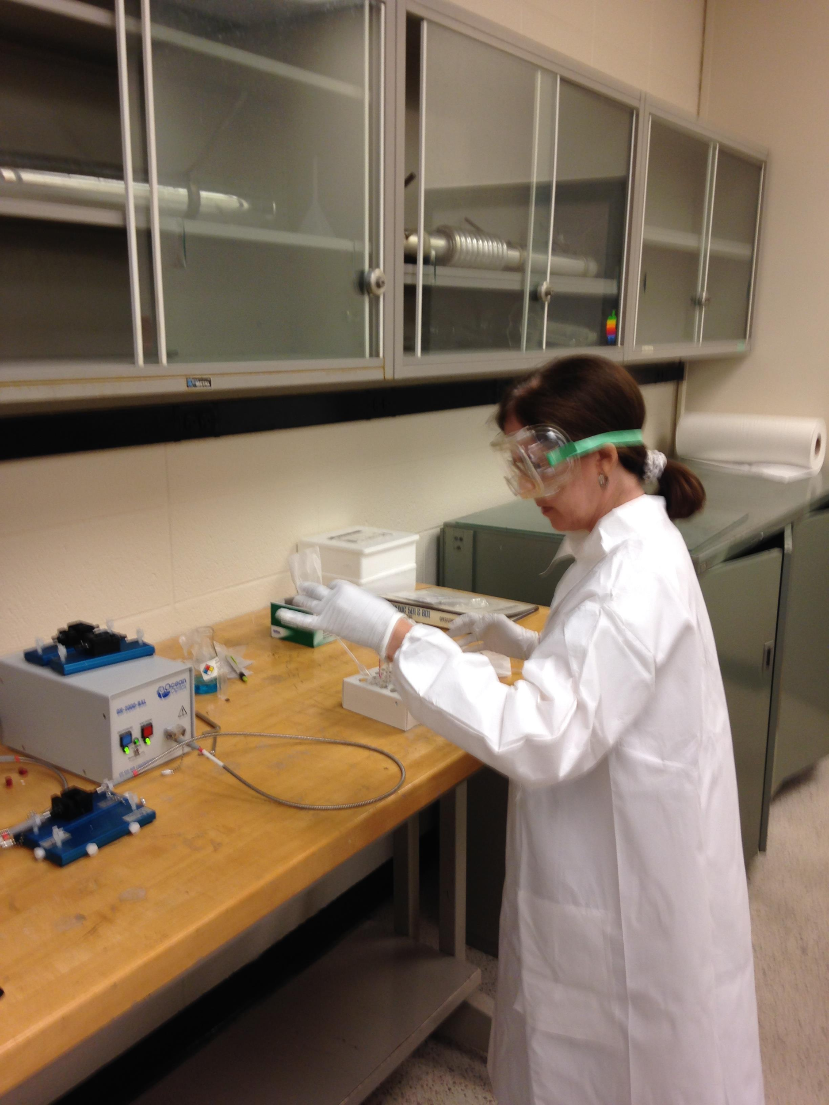
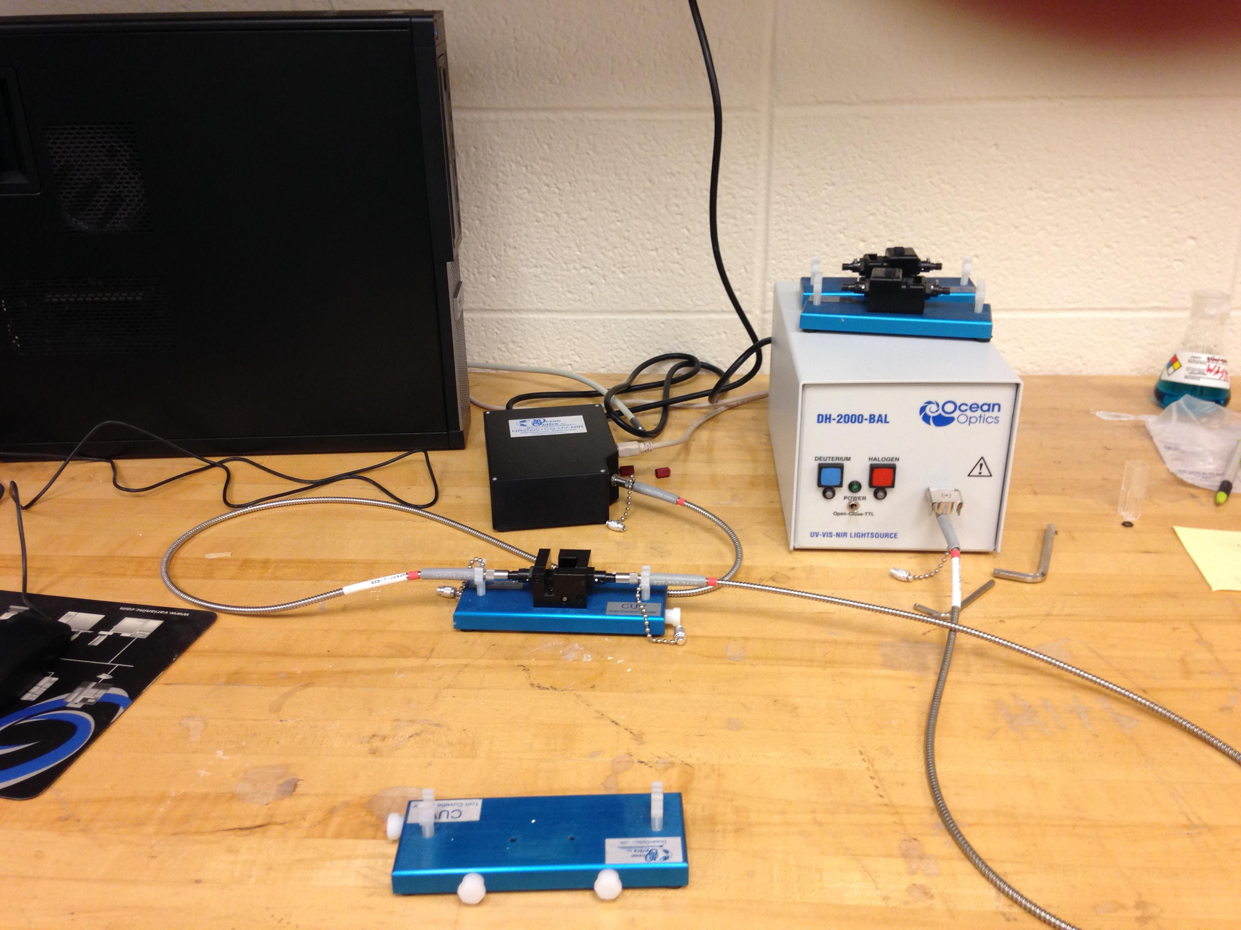
Research Objectives
Analyze known concentrations of each vanadium species
Create corresponding Calibration Plots
http://www.iorodeo.com/content/pack-semi-macro-colorimeter-cuvettes

Slide 13
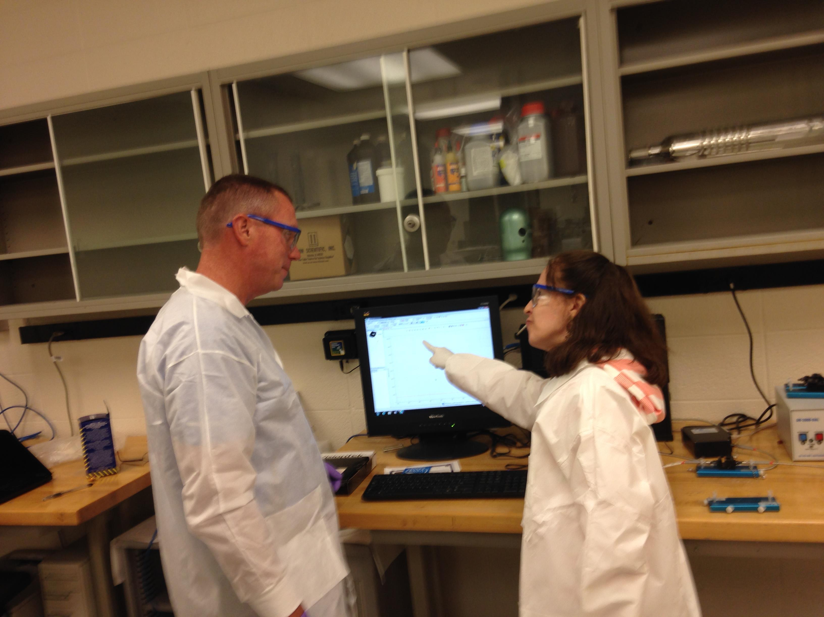
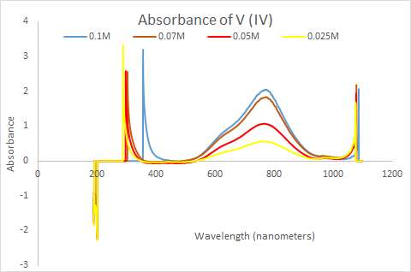
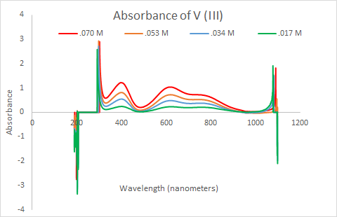
Results
Notes:
V (IV) 765 nm, V (V) 400 nm, V (III) 600 nm

Slide 14
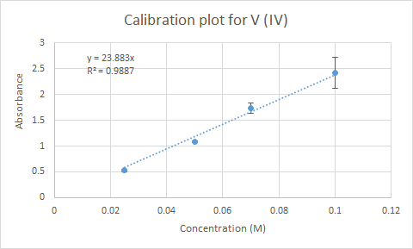
Results
Beer-Lambert Law:
A=Ɛlc

Slide 15
Conclusions
UV-Vis provided usable Calibration Plots for determining concentrations of V (III), V (IV) and V (V).
Generation of a Calibration Plot for V (II) was not readily achievable
Concentration of V (II)
could be determined by
difference

Slide 16
Future Research
Calibration Plots using UV-Vis for V (III), V (IV) and V (V) can be further refined
Methods and
procedures for
V (II) concentrations

Slide 17
Marie’s Unit Plan
Beyond Basic Batteries
Image credit http://www.wcpo.com/news/local-news/hamilton-county/cincinnati/power-outages-affect-more-than-5000-around-uc
Notes:
Three of the copper-zinc-coke batteries produce about 3 volts, and can replace the 3 volt lithium battery in this small clock/calendar/calculator. It has been running for days now, and can probably last months. The calculator works, and the alarm chimes play just fine.

Slide 18
The (anticipated)
Essential Questions:
Can I make a battery instead of buying one?
1. How do batteries work?
2. How long do
batteries last?
3. Why do used batteries power some devices but
not others?
Notes:
Three of the copper-zinc-coke batteries produce about 3 volts, and can replace the 3 volt lithium battery in this small clock/calendar/calculator. It has been running for days now, and can probably last months. The calculator works, and the alarm chimes play just fine.

Slide 19
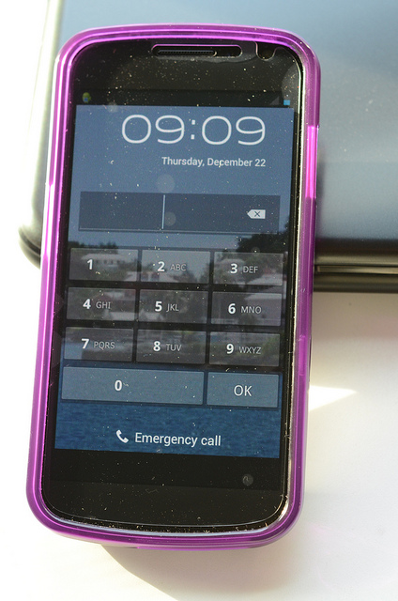
Big Idea
.Energy can be transferred from one thing
to another ?
Image credit: https://kamppeet.files.wordpress.com/2012/09/022.jpg
Notes:
Three of the copper-zinc-coke batteries produce about 3 volts, and can replace the 3 volt lithium battery in this small clock/calendar/calculator. It has been running for days now, and can probably last months. The calculator works, and the alarm chimes play just fine.

Slide 20
Beyond Basic Batteries

Slide 21
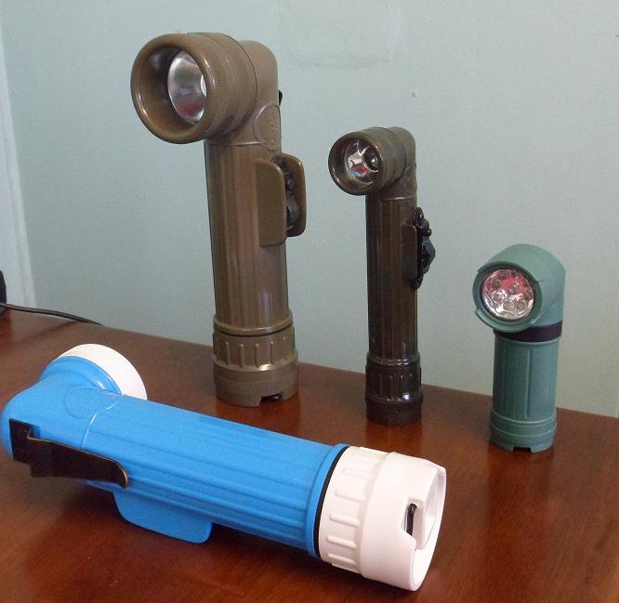
Beyond Basic Batteries
Household inventory
Photo credit: http://msprepper.com/tools/7-best-emergency-electronics-preppers/

Slide 22
Lesson 2 Activity 1

Slide 23
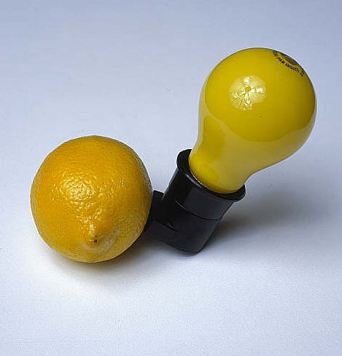
Beyond Basic Batteries
"Capri Battery"
by Joseph Beuys,
1985
National Galleries Scotland
Image credit: http://pictify.com/170250/capri-battery-by-joseph-beuys-1985

Slide 24
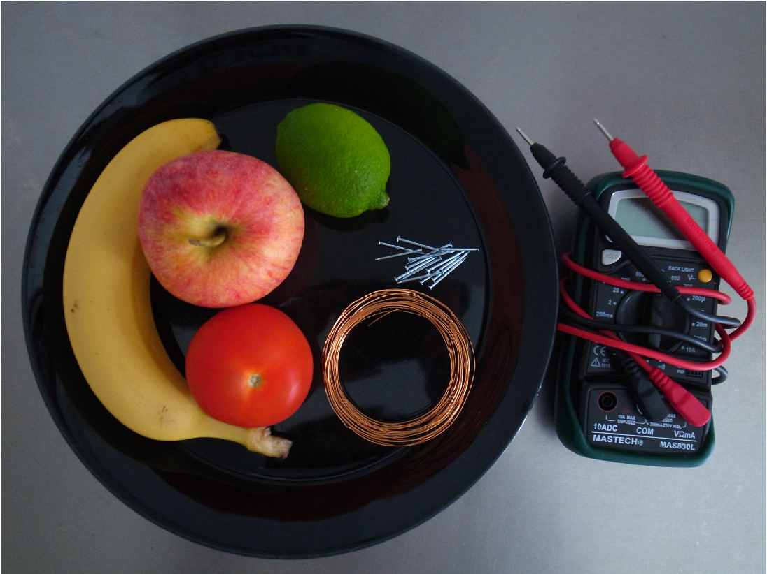
The Challenge
Build the best battery for your needs, ie generate at least ______ for 5 days
Image credit: https://kamppeet.files.wordpress.com/2012/09/022.jpg
Notes:
Three of the copper-zinc-coke batteries produce about 3 volts, and can replace the 3 volt lithium battery in this small clock/calendar/calculator. It has been running for days now, and can probably last months. The calculator works, and the alarm chimes play just fine.

Slide 25
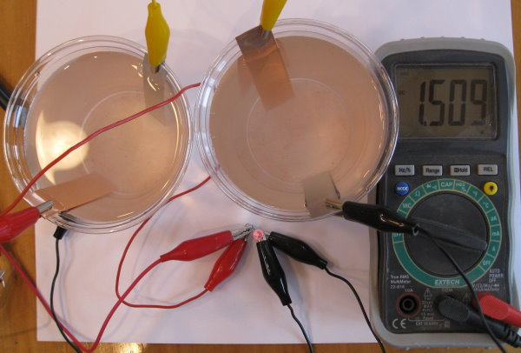
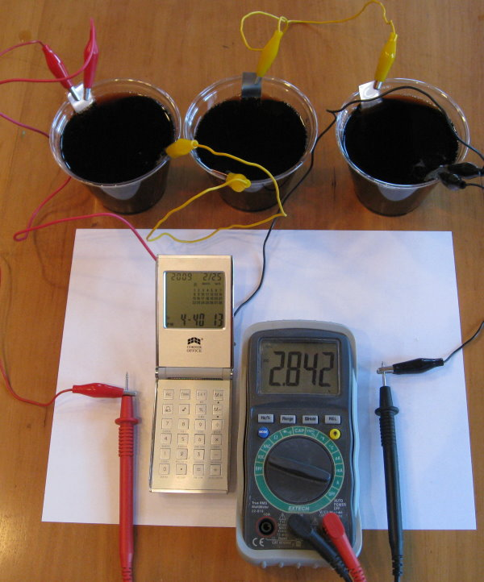
Beyond Basic Batteries
Image credit: http://sci-toys.com/scitoys/scitoys/echem/batteries/batteries.html
Notes:
Two zinc-air cells in series produce about a volt and a half. In the photo above, you can see that this is enough to make a red LED light up. To make it brighter, you can add more cells.

Slide 26
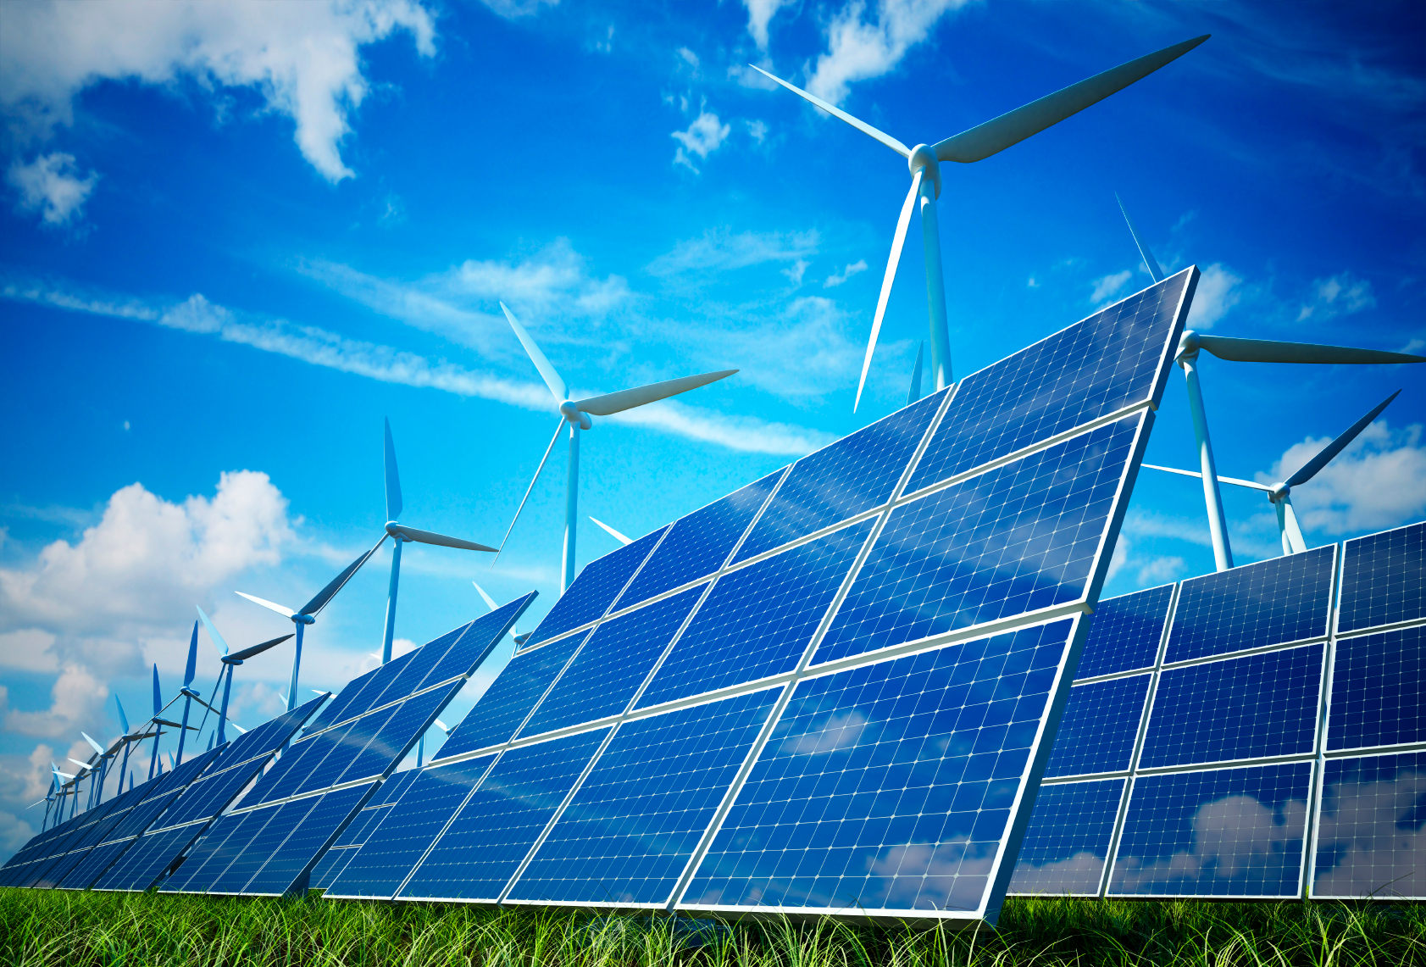
Larry’s Unit Plan
Unit: Transforming Energy with Style!
Big Idea: Energy is never “used”, it is only transformed.
Essential Question:
What Happens to “used”
Energy?
http://www.multitech.com/applications/energy

Slide 27
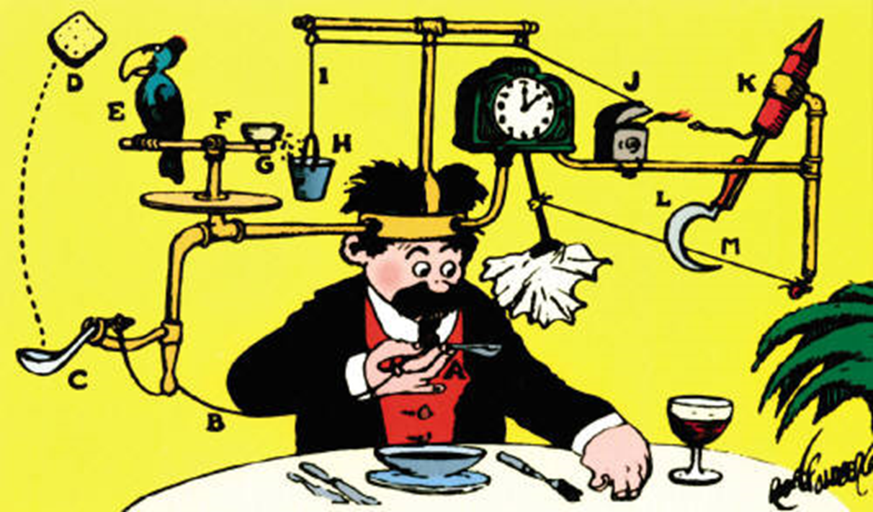
Challenge
Develop a Rube Goldberg Device demonstrating the exchange of Energy
http://www.huffingtonpost.com/paladinregistrycom/the-rube-goldberg-theory-_b_5787074.html

Slide 28
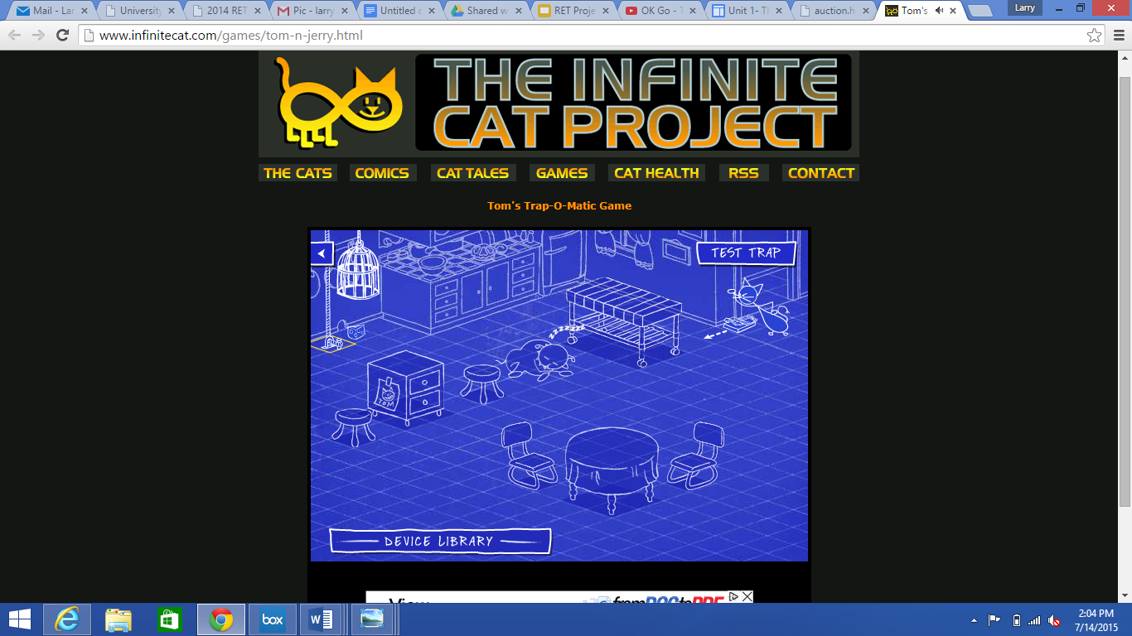
What is a Rube Goldberg?
http://auction.howardlowery.com/Bidding.taf?_function=detail&Auction_uid1=2552150
The Hook
https://www.youtube.com/watch?v=qybUFnY7Y8w
http://www.infinitecat.com/games/tom-n-jerry.html

Slide 29
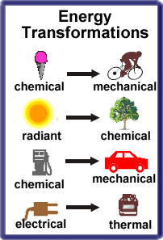
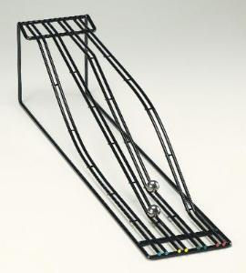
What’s Lost, Not Energy!
Energy Transformations and Conservation
Kinetic and Potential
Energy Ramps
https://www.sargentwelch.com/store/catalog/product.jsp?catalog_number=CP33578-00
http://www.solpass.org/6-8Science/6s/standards/study6.2old.htm

Slide 30
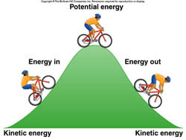
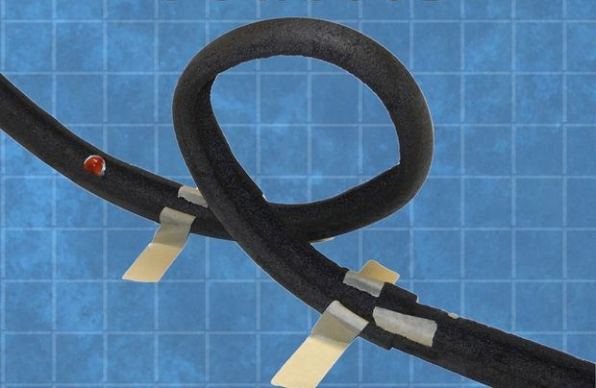
Rollercoaster Mania
Kinetic and Potential energy calculations
Relating potential and kinetic energy in a system
http://www.differencebetween.info/difference-between-kinetic-energy-and-potential-energy
http://www.instructables.com/id/Marble-Roller-Coaster/

Slide 31
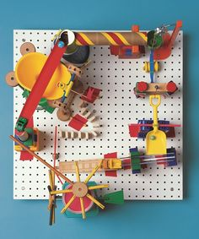
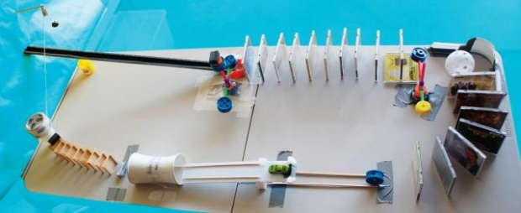
Rube Goldberg Challenge
Assemble
Test
Refine
Finalize (Refine?)
https://www.pinterest.com/gottoteach/rube-goldberg/
http://beta2.curiositymachine.org/index.php?r=activity/view&id=64

Slide 32
Bibliography
Bartolozzi, M. (1989). Development of redox flow batteries. A historical bibliography. Journal of Power Sources, 27(3), 219-234.
Buckley, D. Noel; Gao, Xin; Lynch, Robert P.; Quill, Nathan; Leahy, Martin J.(2014)“Towards optical monitoring of vanadium redox flow batteries (VRFBs)​: an investigation of the underlying spectroscopy” Journal of the Electrochemical Society, 161(4), A524-A534.
Choi, N. H., Kwon, S. K., & Kim, H. (2013).”Analysis of the oxidation of the V (II) by dissolved oxygen using UV-visible spectrophotometry in a vanadium redox flow battery. “Journal of The Electrochemical Society, 160(6), A973-A979.
Ding, C., Zhang, H., Li, X., Liu, T., & Xing, F. (2013). “Vanadium flow battery for energy storage: prospects and challenges.” The Journal of Physical Chemistry Letters, 4(8), 1281-1294.

Slide 33
Bibliography
Hruska, L. W., Savinell, R. F. (1981).”Investigation of Factors Affecting Performance of the Iron‐Redox Battery. “Journal of the Electrochemical Society,128(1), 18-25.
Oei, D. G. (1982).” Chemically regenerative redox fuel cells.”Journal of Applied Electrochemistry,” 12(1), 41-51.
Rychcik, M., Skyllas-Kazacos, M. (1988). Characteristics of a new all-vanadium redox flow battery. Journal of Power Sources, 22(1), 59-67.
Skyllas-Kazacos, M., & Kazacos, M. (2011). “State of charge monitoring methods for vanadium redox flow battery control.” Journal of Power Sources, 196(20), 8822-8827.
Thaller, L. H. (1979). Recent advances in Redox flow cell storage systems. NTIS.

Slide 34
Acknowledgements
RET is funded by the
National Science Foundation
grant # EEC-1404766
👏Thank you all for your time and attention.
👏Thank you to Dr. Anastasios Angelopoulos, Mr. Kevin Tonnis and Mr. Abhinandh Sankar for guidance
👏Thank you to all PD presenters for sharing your expertise.
👏Thank you to fellow RET teachers and Mr. David Macmorine for moral support.
👏Thank you to Dr. Kukreti and Ms. Debbie Liberi for making RET happen here at UC.

